Slide 1
Personal Care Package: self care and stress management Amy Demchak, Employee Wellness Coordinator Indiana State University

Slide 2
Notes:
THE END

Slide 3
Pause

Slide 4
Notes:
THE END

Slide 5
Pause

Slide 6
How stress affects our bodies, mood and behavior www.mayoclinic.org
On your body | On your mood | On your behavior
Headache | Anxiety | Overeating or undereating
Muscle tension or pain | Restlessness | Angry outbursts
Chest pain | Lack of motivation or focus | Drug or alcohol misuse
Fatigue | Feeling overwhelmed | Tobacco use
Change in sex drive | Irritability or anger | Social withdrawal
Stomach upset | Sadness or depression | Exercising less often

Slide 7
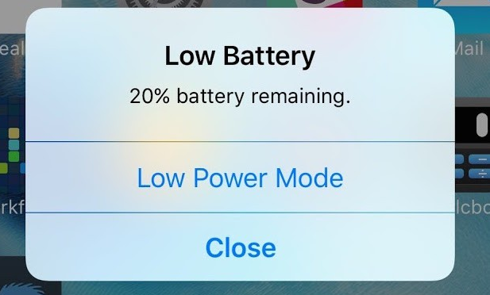
Notes:
We would take action to recharge our phone. We need to be aware (signs of stress) and take action to recharge ourselves. START with breathing…1st hand on chest and belly…practice deep, full breathing

Slide 8
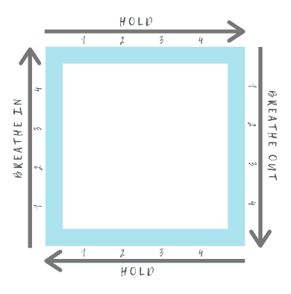
https://veryspecialtales.com/square-breathing/
Notes:
Breathing (10 minutes) THEN practice square breathing START ON BREATHE IN….

Slide 9
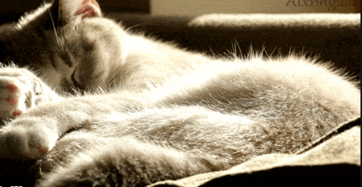
Notes:
Chair yoga (20 minutes)

