Slide 1
State financial aid
Policy and Standard Practice Update
Brooke Kile, Senior Associate Commissioner for Business Solutions
Angel McAllister, State Director for Financial Aid
March 13, 2026

Slide 2
Overview
  Commission (CHE) Leadership Update
  New Claims Rule
  365-Day Rule
  Program Participation Agreements (PPAs)
  State Financial Aid Audits
  Teaching Scholarships
  End-Of-Year Closeouts
  ScholarTrack Updates
  FY27 Updates

Slide 3
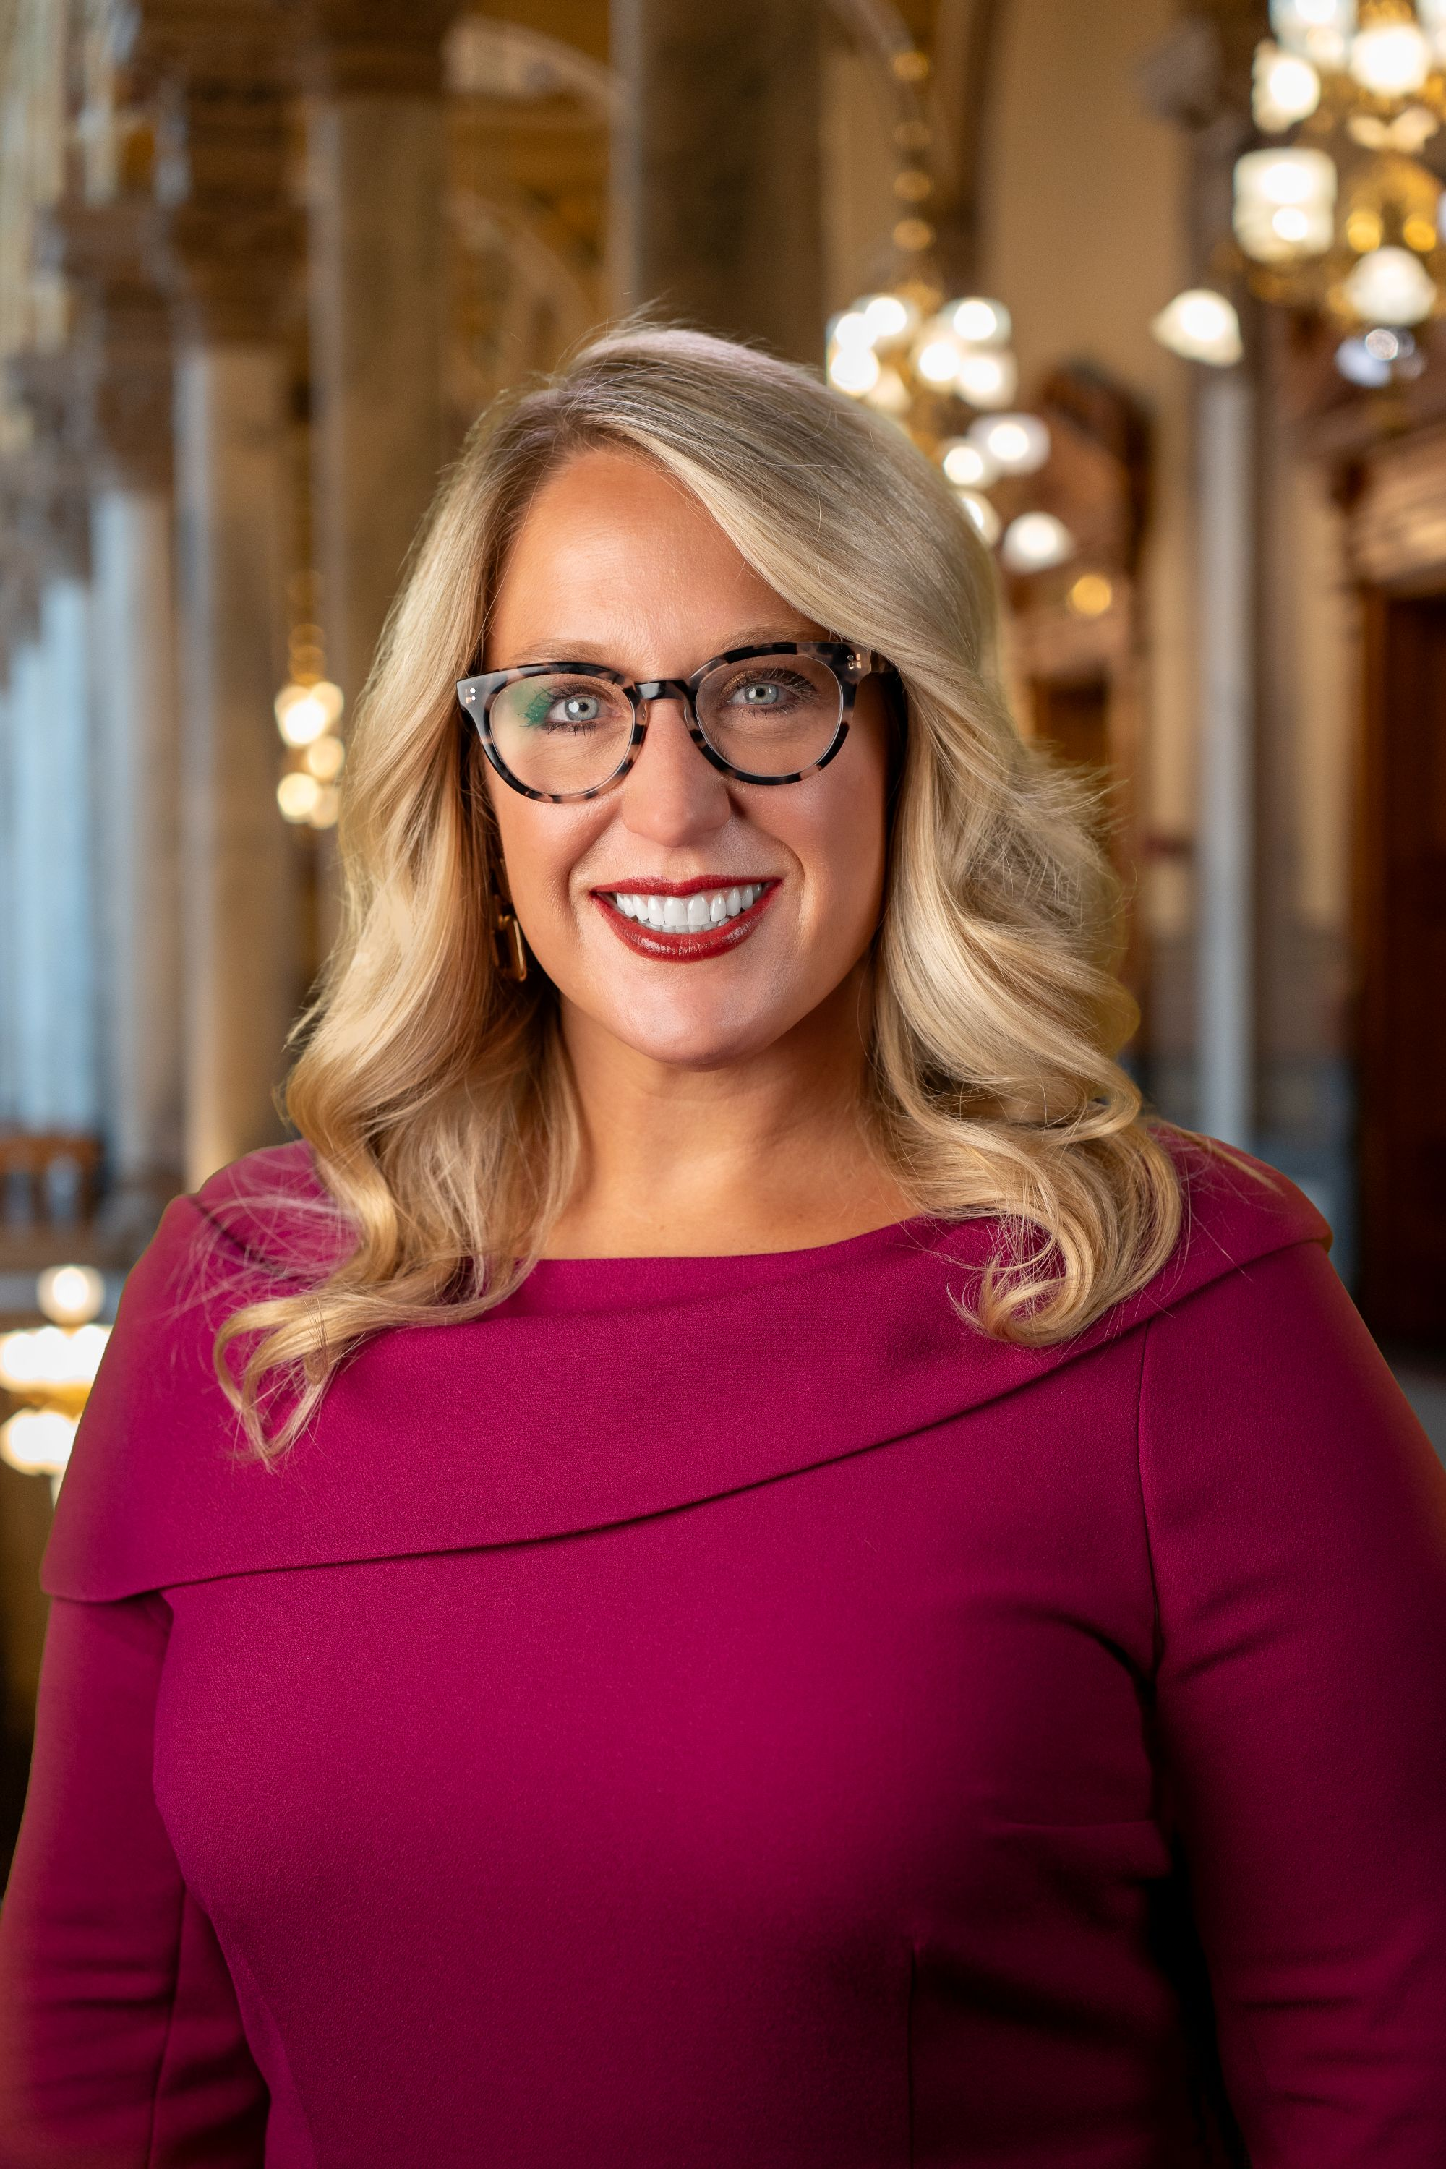
CHE Leadership Update
  Secretary Katie Jenner officially became Indiana’s Commissioner for Higher Education in October 2025 after Chris Lowery concluded his service.
  Indiana’s first Secretary of Education, the state’s top education official, and one of eight secretaries in Governor Mike Braun’s cabinet.
  Dr. Jenner holds a doctorate in education from the University of Kentucky and an MBA from Indiana State University.
  Previously vice President of K-12 Initiatives and Statewide Partnerships for Ivy Tech Community College
  Held various leadership positions at Madison Consolidated Schools, in addition to being a teacher.

Slide 4
CHE Leadership Update
Katie Jenner, Commissioner
Josh Garrison, Chief of Staff, Office of Education
Jacqueline Kronk, Chief Strategy Officer, Office of Education
Michelle Ashcraft, Senior Associate Commissioner and Chief Operating Officer, CHE
Courtney Schaafsma, Chief Financial Officer, Office of Education
Cody Robison, Deputy Chief Financial Officer, Office of Education

Slide 5
New Claims rule
Supports timely claim submission and reduces delays in student award processing.
Improves efficiency and accuracy in awarding, ensuring students receive aid when they need it.
Strengthens budget management and future fiscal preparation.
Institutions with monthly enrollments will operate on an alternative schedule to account for their term structures.
Exceptions may be granted for documented appeals, ScholarTrack system issues, or Commission‑related delays that prevent timely claim submission.

Slide 6
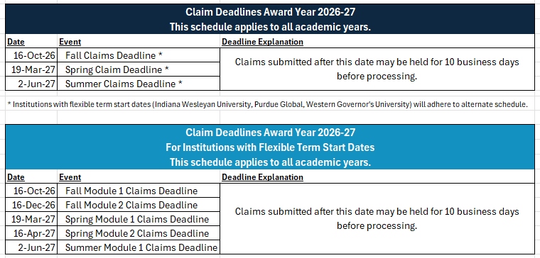
Claims deadline and Schedule

Slide 7
365-day rule
Beginning in the 2026–2027 academic year, the 365‑day claim rule will change.
Currently, institutions may submit late claims in ScholarTrack up to 365 days after the award expiration date.
NEW: Claims submitted after 365 days of award expiration will be held until the end of the fiscal year to determine if funding is available.

Slide 8
Program Participation agreements (ppa)
Each college participating in Indiana state financial aid programs must have
a Program Participation Agreement (PPA) on file for students to receive state aid at the university.
Current PPAs will expire on June 30, 2026, and new PPAs will become effective immediately at the start of the new fiscal year on July 1, 2026.
New PPAs will require a signature from the university president, similar to the federal PPA, and a signature from the Financial Aid Director.
The signed PPA must be returned to the Commission no later than June 30, 2026.
Notes:
T2T is added to the new PPAs – no more grant agreements will be required for disbursements.
Additional language regarding security breach, data, and claims language has been added to the new PPAs.

Slide 9
State Financial Aid Audits
Recent audit reviews show several institutions have not submitted their required
AUP reports.
Annual (or bi-annual) audits are required to continue participating in state financial aid programs.
Audit review focuses on eligibility determinations, disbursement accuracy, and proper use of state funds.
This summer, institutions will receive notification of the most recent audit on file along with required next steps.
Noncompliance may impact future program participation and state aid disbursements.

Slide 10
Teaching Scholarships
The Transition to Teaching Scholarship will be available in ScholarTrack beginning in the 2026–2027 academic year.
The program coordinator will provide a webinar and training on how to claim awards in ScholarTrack.
Student teaching scholarships will continue to be processed through invoices.

Slide 11
FY26 close
For FY26 all claims must be entered in ScholarTrack by May 31, 2026, to meet the fiscal year end payment deadline.
Claims submitted after the deadline will be delayed until we begin processing payments for FY27.

Slide 12
CVO End-of-year close out
At the start of FY26, all institutions received their prorated amounts for the
2025-2026 AY.
We will conduct an end-of-year settle-up to ensure the entire appropriation was prorated on actual claims for the 2025-2026 AY.
  Private institutions will be made whole according to Indiana code.
In June, any claims not covered by the CVO fund will have a “Not Paid” status and institutions will receive an Excel spreadsheet detailing which student claims were not covered by the CVO fund and should be covered by the institution.

Slide 13
ScholarTrack Updates
There are new changes to the National Guard Supplemental Grant (NGSG).
  Summer claims are now allowed.
  Students can use NGSG and the 21st Century Scholarship together for 2 academic years.
2nd Workforce Ready Grant began during the 2025-2026 academic year.
  Students can use WRG to complete a 2nd certificate.
Eligibility changed for teaching scholarships.
  To qualify for minority teaching scholarships, students must reside or previously resided in an underserved county:
    Allen, Marion, Lake, St. Joseph, and Vanderburgh County

Slide 14
Fiscal year 2027 updates

Slide 15
FY27 Workforce ready grant
To meet the growing demand for the Workforce Ready Grant and
ensure spending stays within the appropriation, the CHE will impose institutional spending caps on all participating institutions.
These caps will be based upon consideration of historic spending, student demand, and program outcomes.
Specific information will be provided to individual institutions by May 1, 2026.

Slide 16
FY27 adult student grant
The Commission anticipates similar demand for the Adult Student Grant in
FY27 as demonstrated in FY26.
As a result, CHE expects to announce the closure of the Adult Student Grant application window in late fall 2026 / early winter of 2027.
CHE plans to announce the official application deadline sometime in November or early December 2026.

Slide 17
Questions?

Slide 18
Angel McAllister
State Director for Financial Aid
Brooke Kile
Sr. Associate Commissioner for Business Solutions
CollegeFA@che.in.gov

