Slide 1


Stronger Together:
Basics of Compliance and Supporting Students
Professional Judgment & Satisfactory Progress

Slide 2

Professional Judgement

Slide 3

ISFAA 2026 Conference
Professional Judgment (PJ) – What Is It?
  Decision process to alter standard assessment when unique or exceptional circumstances impact a family’s ability to pay for college
  A FUN FACT: 1986 was the first time PJ language was included in federal legislation
  Effective use requires a solid understanding of need analysis
  Exercising Professional Judgment comes with responsibility
    Stewardship of funds
    Advocating for access
    Managing family expectations – outcome may not provide what they expect
    PJ is time-consuming & an office must find a proper balance

Slide 4
ISFAA 2026 Conference
Professional Judgment (PJ)
  The FAFSA Simplification Act distinguishes between different categories of professional judgment
    Dear Colleague Letter GEN 22-15
    A student may have both a special circumstance and unusual circumstances
  Special Circumstances refer to the financial situations (loss of a job, etc.) that justify an aid administrator adjusting data elements in the COA or in the SAI calculation.
  Unusual Circumstances refer to the conditions that justify an aid administrator making an adjustment to a student’s dependency status based on a unique situation (e.g., human trafficking, refugee or asylee status, parental abuse or abandonment, incarceration), more commonly referred to as a dependency override.

Slide 5
ISFAA 2026 Conference
Professional Judgment (PJ)
  As an aid administrator, you may modify data used to
    Calculate the Student Aid Index (SA)
    Cost of Attendance
    Dependency
  Must be made on a case-by-case basis with unusual circumstances
    Must document original decision and any subsequent adjustments
    Cannot change the formula or tables used in SAI (change element like taxes paid)
    Additional information in Chapter 5 of the Federal Student Aid Handbook

Slide 6
ISFAA 2026 Conference
Professional Judgment (PJ)
  Examples of special circumstances
    Change in employment, income or assets
    Medical, or dental expenses
    Child care or dependent case
    Examples of expenses you may not consider
      Loan fees for non-Federal student loans borrowed by students
      The costs of obtaining a license, certification, or first professional credential are no longer restricted to a one-time allowance.
      Making an otherwise federally independent student dependent
      Treat an ineligible student as eligible

Slide 7
ISFAA 2026 Conference
Building Policy and Process
  Will you have a committee?
  Will more than one person review each request?
  Will you have a standard documentation worksheet?
  Will you have a standard for documentation?
  Will standard communication be used to notify a family of the outcome?
  Will PJ be used for all sources of Aid?
  What aid will be offered if need increases?
  Does your website reflect the process and requirement to inform families they may submit a request for review?

Slide 8
ISFAA 2026 Conference
Professional Judgment (PJ) – It’s all About People
Freedom to exercise professional judgment is at the heart of the financial aid profession but with freedom comes responsibility
“To give away money is an easy matter, and in any (wo)man’s power. But to decide to whom to give it, and how large and when and for what purpose and how is neither in every (wo)man’s power, nor an easy matter. Hence, it is that such excellence is rare, praiseworthy and noble.”
Aristotle

Slide 9
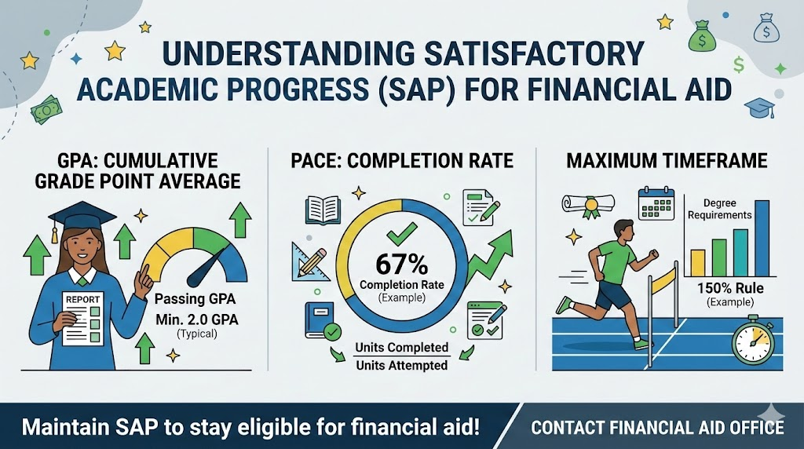
Satisfactory Academic Progress

Slide 10
ISFAA 2026 Conference
Satisfactory Academic Progress
  668.34 (a) Satisfactory Academic Progress policy
    Must establish a reasonable policy for determining whether an otherwise eligible student is making satisfactory academic progress in his or her educational program and may receive assistance under Title IV HEA
  Students must be reviewed at regular intervals to determine if satisfactory academic progress requirements are being met
  Standards must be consistently applied

Slide 11
ISFAA 2026 Conference
Satisfactory Academic Progress
  The components that must be evaluated:
    Qualitative measure that is cumulative grade based
    Pace (quantitative measure)
      Must be cumulative
      Student’s progression to ensure completion within maximum time frame
      Total Earned Hours / Total Attempted Hours (must be at least 67%)
      Successfully completed clock hours/Scheduled clock hours and
      Weeks successfully completed hours should take to complete
    Maximum time frame – cannot exceed 150% of published length of program

Slide 12
ISFAA 2026 Conference
Satisfactory Academic Progress
  Appeals
    If allowed, SAP policy must specify the conditions under which a student may appeal
      Why they did not make SAP AND What has changed that will allow the student to make SAP
      Must notify the student of the SAP review
    Probation
        Appeal AND Mathematically be able to make SAP in next payment period OR
      Be successfully following an academic plan designed to ensure the student will be able to meet SAP by a specific point in time

Slide 13
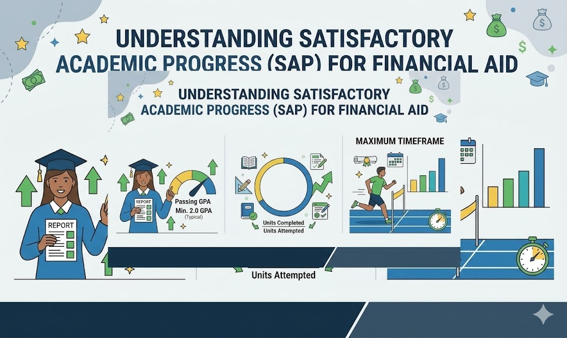
Federal Verification

Slide 14
Federal Verification
ISFAA 2026 Conference
  In accordance with 34 C.F.R. § 668.53(b), schools are required to provide specific information to applicants whose FAFSA is selected for verification
  Chosen randomly by the Department of Education
  Schools have the authority to verify additional students
  Must provide an explanation of their role, list of documents, deadline and consequences for failing to meet deadline
  Must Resolve Conflicting Information
    https://fsapartners.ed.gov/knowledge-center/fsa-handbook/fsa-assessments/verification

Slide 15
ISFAA 2026 Conference
Federal Verification
  Standard Verification Group
    Adjusted Gross Income, Income Earned from work, U.S. Income Tax Paid, Untaxed Portions of IRA distributions, Untaxed portions of Pensions, IRA deductions and payments, tax exempt interest, education credits, Foreign Income Exempt from Taxation
    Custom Verification Group
      Must appear in person and sign a Statement of Educational Purpose using a valid, unexpired government issued photo ID
      Aggregate Verification Group
        Requires Income AND Identify Verification
        Exclusions
          Students who are only eligible for unsubsidized Title IV aid
          Applicant verified by another school

Slide 16

Return of title iv funds (R2TIV)
Regulatory Requirements and Procedures

Slide 17
ISFAA 2026 Conference
References
  Federal Student Aid Handbook Volume 5
  § 668.22 Treatment of title IV funds when a student withdraws.
    Does your school take attendance? Important factor in determining calculation
    Must provide students with information about the requirements
    Remember that a student begins earning Title IV funds on the first day of attendance, even if the student withdraws before a school’s census date, and the school must perform an R2T4 calculation using the number of days the student attended or the number of clock hours the student was scheduled to attend.

Slide 18
ISFAA 2026 Conference
What is R2T4?
  Definition: The federal law governing the return of financial aid when a student stops attending school.
  The Principle: Federal aid is awarded with the assumption that the student will attend for the entire period of enrollment for which aid is offered.
  The Goal: To calculate the amount of “earned” aid based on the time the student is enrolled.
  Applies to: Students who withdraw completely (officially and unofficially

Slide 19
ISFAA 2026 Conference
Which Funds Are Included?
  Title IV Programs
    Federal Pell Grant
    Federal Supplemental Grant
    Direct Subsidized and Unsubsidized Loans
    Federal PLUS Loan (Parent or Graduate Student
    TEACH Grant
    NOTE: Federal Work Study is not included (since the student must earn)

Slide 20
ISFAA 2026 Conference
Key Concepts and Terms
Withdrawal Date: The last date of academic attendance (official or unofficial).
Earned Aid: Aid the student keeps because they completed a portion of the term.
Unearned Aid: Funds that must be returned to the federal government.
60% Rule: If a student completes more than 60% of the term, they earn 100% of their aid.
Post-Withdrawal Disbursement (PWD): Earned aid that was not yet disbursed at the time of withdrawal.

Slide 21
ISFAA 2026 Conference
The 60% Rule
Before 60%: Aid is prorated based on the percentage of the term completed.
After 60%: No return of funds required; 100% of aid is earned.
Example: If a term has 100 days, withdrawing on day 30 (30% completed) means the student has only earned 30% of their aid.

Slide 22
ISFAA 2026 Conference
Steps in the R2T4 Calculation
Determine Withdrawal Date
Calculate % of Period Completed: Days attended / Total days in term
Calculate Amount of Earned Aid ****
Calculate Unearned Aid: Total Disbursed – Earned Aid
Determine Return Responsibility: School vs Student

Slide 23
ISFAA 2026 Conference
Responsibility for Returning Funds
Institution Returns: Lesser of Total unearned aid or Unearned percentage
Student Returns: Remaining unearned amount (after school’s return)
Grant Overpayment: Student must repay >50% of the unearned grant
Loan Repayment: Student repays unearned loan funds per the terms of the MPN

Slide 24
ISFAA 2026 Conference
Order of Return of Funds
Direct Unsubsidized Loans
Direct Subsidized Loans
Direct PLUS Loan
Federal Pell Grant
Iraq and Afghanistan Service Grants
Federal Supplemental Grant
TEACH Grants

Slide 25
ISFAA 2026 Conference
Institutional Timeline & Deadlines
Calculate R2T4: Within 30 days of determination
Return Funds: Within 45 days of determination
Notify Student of PWD: Within 30 days of determination
Notice of Student of Overpayment: Within 30 days of determination

Slide 26
ISFAA 2026 Conference
Consequences for Students
Balance Owed: The return of funds may create a balance owed to the institution
Loss of Future Eligibility: Failing to resolve a grant overpayment leads to loss of future Title IV aid
Transcript Hold: May withhold transcripts if a balance is owed
SAP Issues: Withdrawals may impact Satisfactory Academic Progress

Slide 27
Thank you!

